Slide 1
Multi-Agent System for Effective Pesticide Management
(ESC205A)
Contributors:-
Abhishek Agarwal - 2016126
Ankur Rastogi - 2016131
Ankur Sharma - 2016225
Arnav Kumar - 2016228
Ishaan Bassi - 2016238
Kaustav Vats - 2016048
Lakshya Bansal - 2016240
Raghavv Goel - 2016179
Sharan Pai - 2016266
Deepak Singh - 2016032

Slide 2
Problem Statement
Pesticides are a two edged sword : too much or too less will impact the plant growth
Use of excess of pesticides causes water and land pollution
Harmful effects on people in spraying fields due to direct contact
People are unaware of amount of pesticide to be used

Slide 3
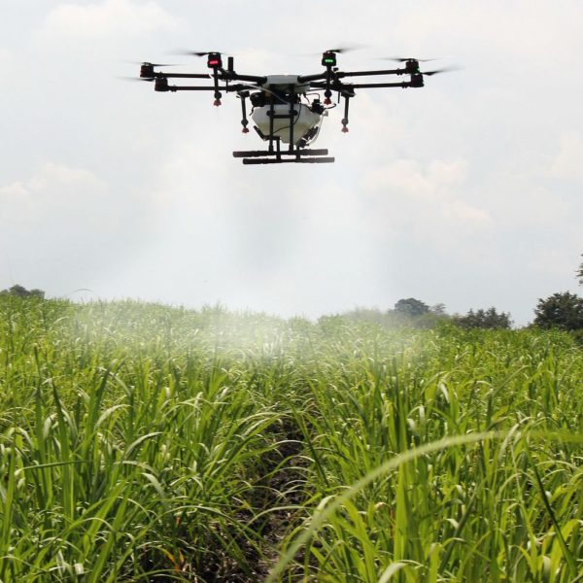
Proposed solution
Use drones for spraying pesticides
Amount of pesticide to be sprayed is optimised using AI
Path by each drone is optimised to minimize the fuel consumption
Drones return to starting point for refueling

Slide 4
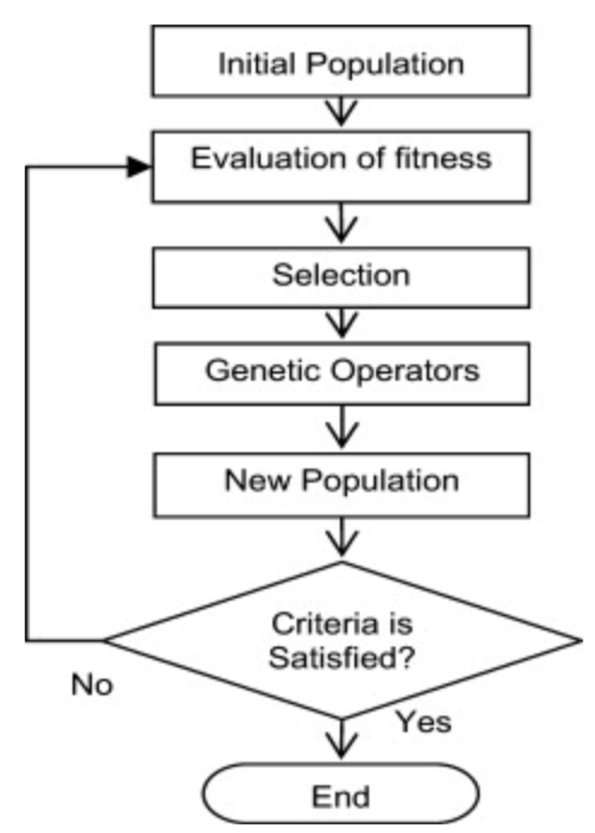
Genetic Algorithm
Genetic Algorithm to find optimal path with given constraints
Gene - Tuple denoting Agent and Fields to cover
Chromosome - Set of Genes
Fitness Function - Calculate cost of visiting each field. Cost is denoted by weighted summation of various factors(Fuel, Distance between Fields, etc)
Stopping Condition - When no new changes observed or enough iterations completed(500)

Slide 5

Simulation and Experiments
https://drive.google.com/file/d/1h9c7Yi0bmvhBCi3oW2AIFk5yGfHKFWEf/view?usp=sharing

Slide 6
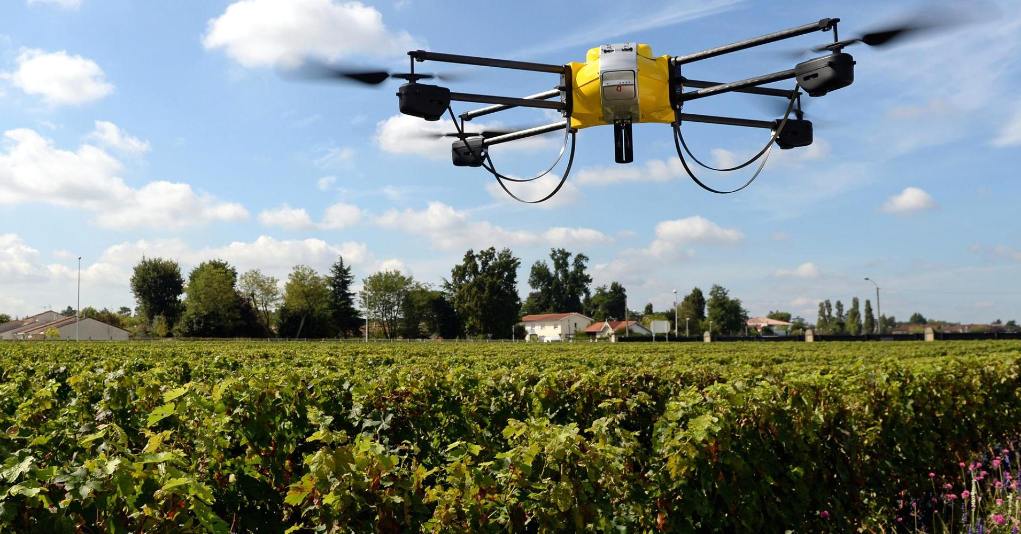
Conclusion
Using AI algorithms in agriculture is very beneficial for the environment
Framers are less prone to diseases
Water, pesticides and other precious resources are not wasted
Ensures the maximum yield of each and every crop

Slide 7
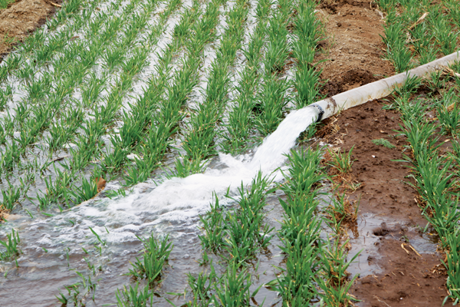
Future Plans
Irrigation Consumes 70% of world’s total water withdrawal
60% of water diverted to farms is wasted
“With the current water management Practice, by 2050 the global agricultural sector will need to double the amount of water used to feed the world”
Solution - Use of Drip Irrigation and Machine Learning

Slide 8
Genetic Algorithm Code
(Link to Github Repository)
https://github.com/kaustavvats/Effective-Pesticide-Management

Slide 9
References
https://www.researchgate.net/publication/286042190_Effects_of_Pesticides_on_Environment
https://www.ncbi.nlm.nih.gov/pmc/articles/PMC2984095/
https://link.springer.com/chapter/10.1007/978-94-007-7890-0_6
https://www.intechopen.com/books/environmental-health-risk-hazardous-factors-to-living-species/pesticides-environmental-pollution-and-health
https://www.wired.com/2006/03/farms-waste-much-of-worlds-water/

Slide 10
Thank You
Any Questions?

Slide 11
